Slide 1
TITLE: Detection of Human Presence Team No. B13 TEAM MEMBERS:
RA1911027010058 YUVRAJ SINGH CHAUHAN RA1911028010121 DARSHIL KETAN SHAH RA1911030010057 GOKHALE MAYANK ASHWIN
RA1911031010061 ADITYA PRATAP SINGH

Slide 2
PROBLEM/PAIN POINT/OPPORTUNITY IDENTIFIED
- Not able to keep track of customers at store, at given point of time and difficulty in getting insights due to lack of data and following covid guidelines.
- All institutions, workplaces and businesses can use our project to get data on how many visitors enter, leave the store and at what time.
- Social distancing is the need of the hour in the Covid-19 pandemic. Our project also helps prevent overcrowding.
- This can be done by keeping track of the number of people in a given space at any given point of time.
- It is also applicable in educational institutes and hospitals to keep track of people entering and leaving for attendance and record purpose.

Slide 3
BRIEFLY DESCRIBE THE SOLUTION/ INNOVATION TO ADDRESS THE PROBLEM/OPPORTUNITY IDENTIFIED
It aims to track the number of people present at a place and can be used in stores, restaurants, malls, etc. to get data on how many visitors enter a store and at what time. To know how many visitors actually become customers.
- Reduces cost of operation as it is autonomous, so human error and costs are eliminated.
- It helps implement COVID-19 norms at public places by preventing overcrowding , by keeping a count of people present there at a given time.
- It is financially viable as it only needs a camera and a computer.
- Helps businesses better understand customer patterns and target sales accordingly.

Slide 4
HIGHLIGHT THE UNIQUENESS/INNOVATIVE COMPONENT OF THE PROPOSED INNOVATION/SOLUTION
- Our USP - financially viable and has a wider range of applications.
- Stores/Hospitals in general have normal security cameras, with the help of our application installed in the cameras the shopkeeper/hospital will be able to track the number of people entering the shop/hospital without incurring any extra cost.

Slide 5
DESCRIBE THE TECHNOLOGY INVOLVES AND TECHNICAL FEASIBILITY FOR THE PROPOSED INNOVATION/SOLUTION
Technology involved -
Data wrangling using Numpy
Video processing using CV2
Information gathering into the Database using SQL
(Not yet finalised) Deployment - Streamlit
Security Camera

Slide 6
DESCRIBE THE BUSINESS/MARKET POTENTIAL OF THE PROPOSED INNOVATION/SOLUTION INTO VENTURE/START-UP
● Banks - Banks can track the number of people in the Bank at any time and it can help the bank to limit the number of people in the bank to avoid overcrowding of the counters.
● Examination - Schools and colleges can use our software by asking students to install it and run it during their exams to ensure that they do not leave the exam room.
● Hardware suppliers for camera - Manufacturing of modified cameras with preinstalled software for third party buyers
● Commerce businesses - Will help the shopkeeper to track the number of customers in the shop to avoid overcrowding.
● Government – The government can use it implement Covid protocol and SOPS; it will also help to control crowds and large public gatherings.

Slide 7
EXPLAIN THE CONSTRAINTS/RISKS ASSOCIATED WITH THE INNOVATION/SOLUTION AND STRATEGY TO TACKLE THESE
Software Malfunction : The software might malfunction and the system might shut down.
Solution : A person must be assigned to check on the system once in a while.
Hardware Malfunction : The hardware itself might malfunction which will stop all the functioning of the system.
Solution: Keeping backup hardware parts so that the problems can be replaced as soon as possible.
Hardware compatibility : The hardware might not be compatible with the software created.
Solution: Keeping only modern hardware so that any software can be run on it and updates can be installed.

Slide 8
IMPLEMENTATION PLAN WITH TIMELINE TO CONVERT THE INNOVATION/SOLUTION TO A VENTURE/STARTUP
● Start small by approaching local businesses and checking if the software runs well in real life environments.
● Gradually Expand & Penetrate Market : Once Step 1 is achieved, we will move on to the large local institutions
● Product Development
● Diversification : Diversify the software to cover all the proposed aspects.
Traction
● Affiliate Program
● Public Relations
● Search Engine Marketing and Ads on social networks and display media
● Offline Media
● Email marketing

Slide 9
TEAM COMPOSITION AND COMPETENCY AND SKILL SET TO TURN THE INNOVATION/SOLUTION INTO START-UP
To do list –
Data wrangling using Numpy
Video processing using CV2
Information gathering into the Database using SQL
(Not yet finalised) Deployment - Streamlit
Work will be distributed across all members-
Yuvraj Singh Chauhan
Darshil Ketan Shah
Mayank Gokhale
Aditya Pratap Singh

Slide 10
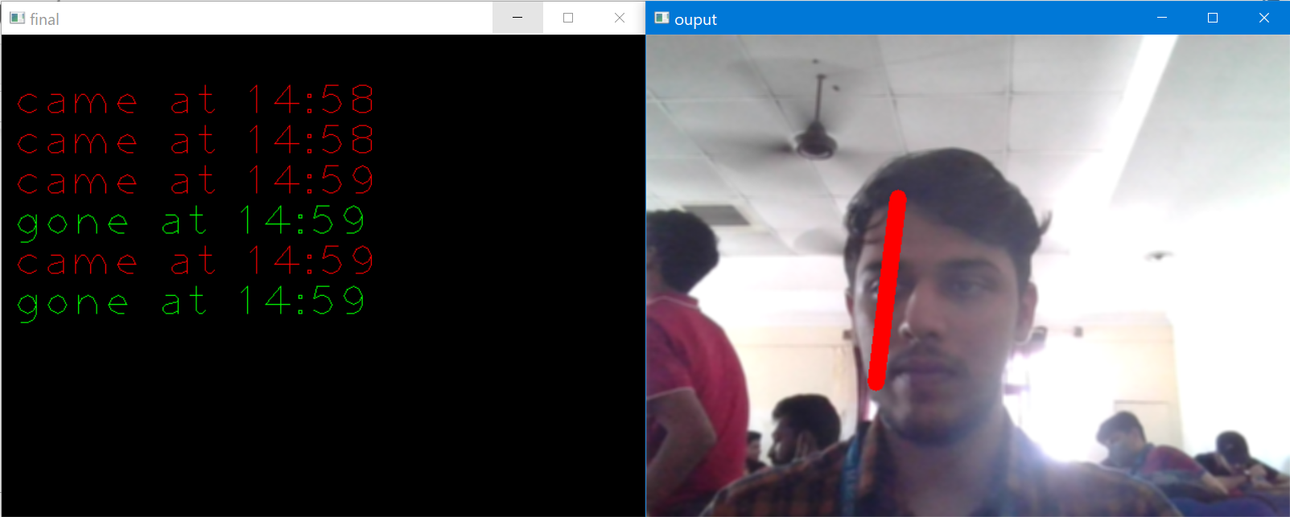
PHOTOGRAPHS: TEAM

Slide 11
THANK YOU

